Slide 1
Comsol multiphysics
Brief of the work done/things learnt
3rd June 2023 – 7th June 2023
AMARNATH
MS22070

Slide 2
Brief Summary
-Basic Understanding of Comsol
-Ray Tracing and Spot diagrams in Ray tracing
-Convex Lens and lens Maker’s formula
-Laser cavity (laser between two mirrors and equiconvex lens arrangement)
-Telescope using Mirrors arrangement
-slight idea of using Multiphysics tab , did thermal actuator for it as tutorials were available.

Slide 3
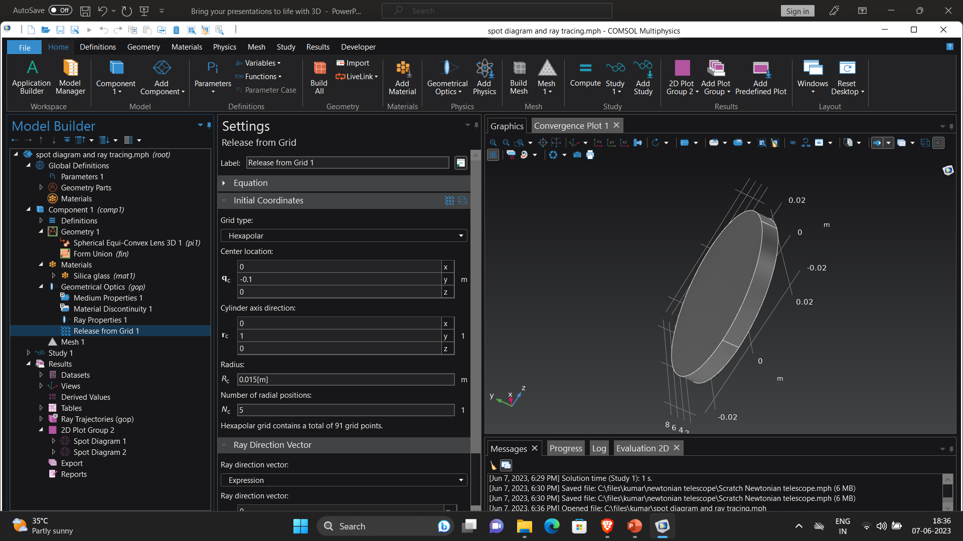
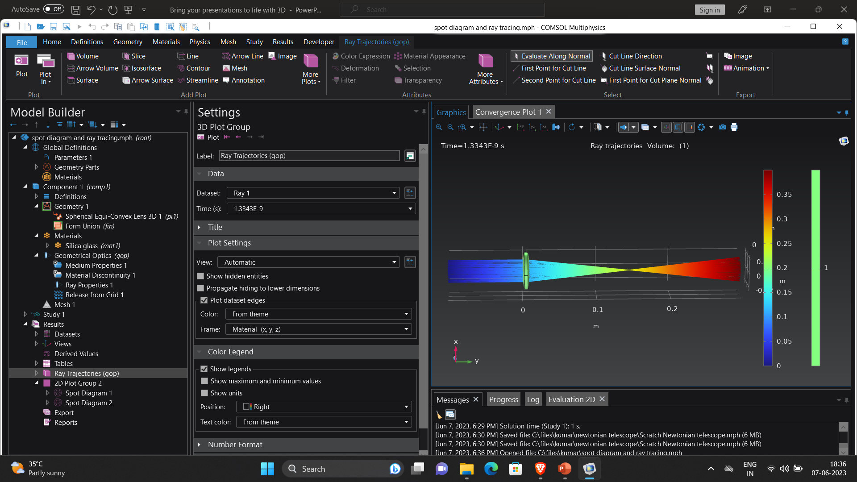
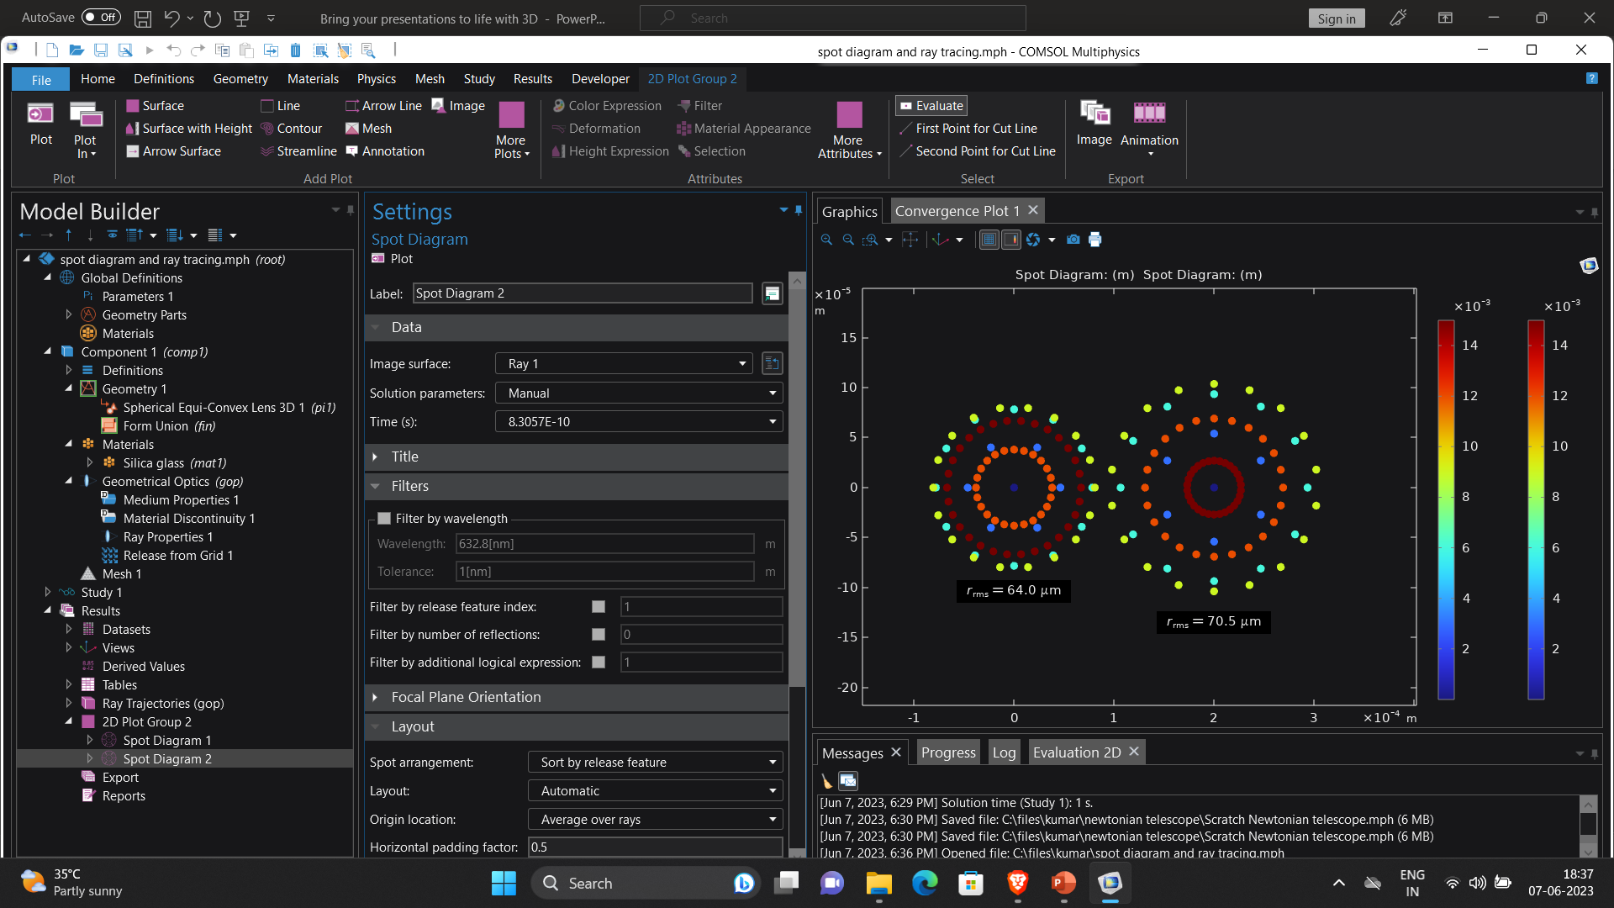
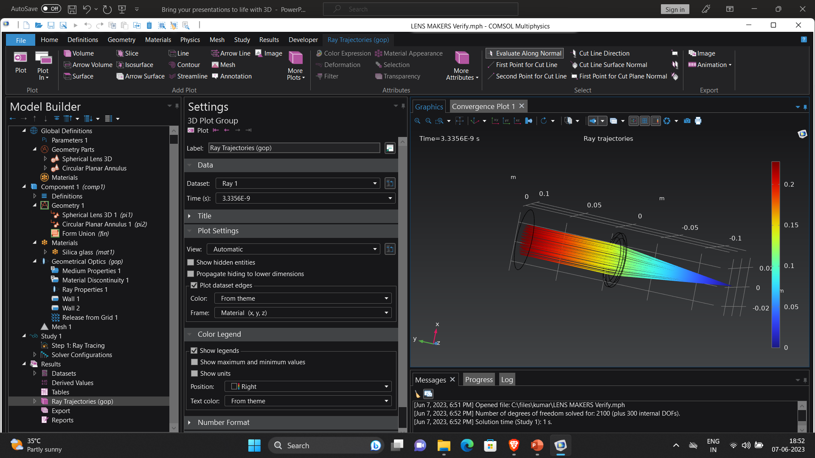
Ray tracing and spot diagrams etc.

Slide 4
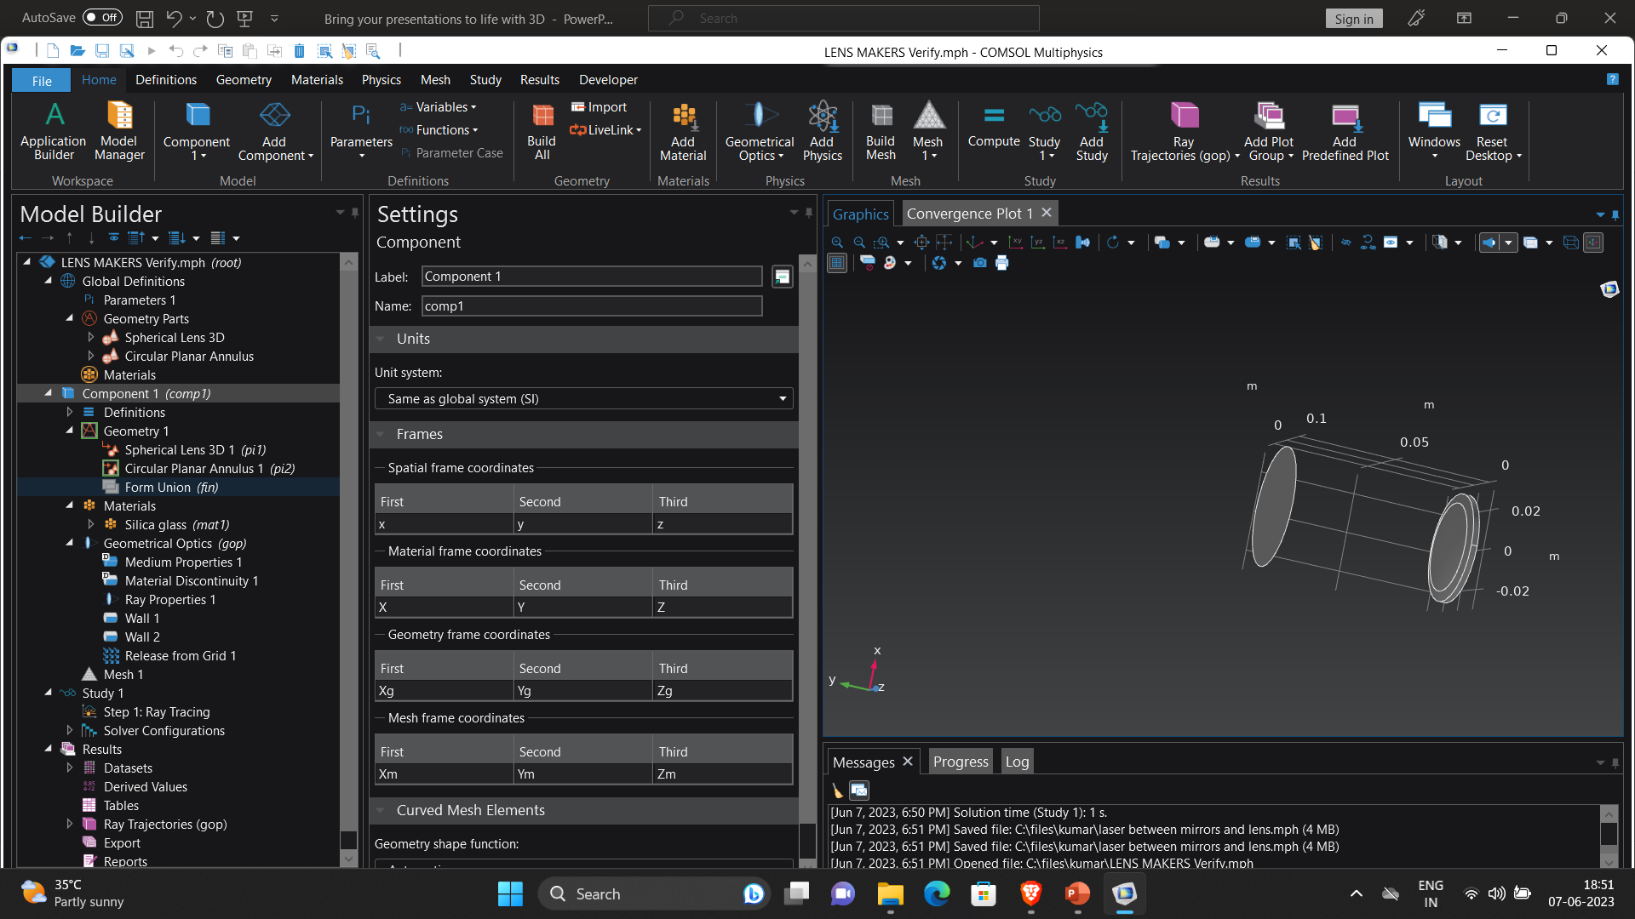
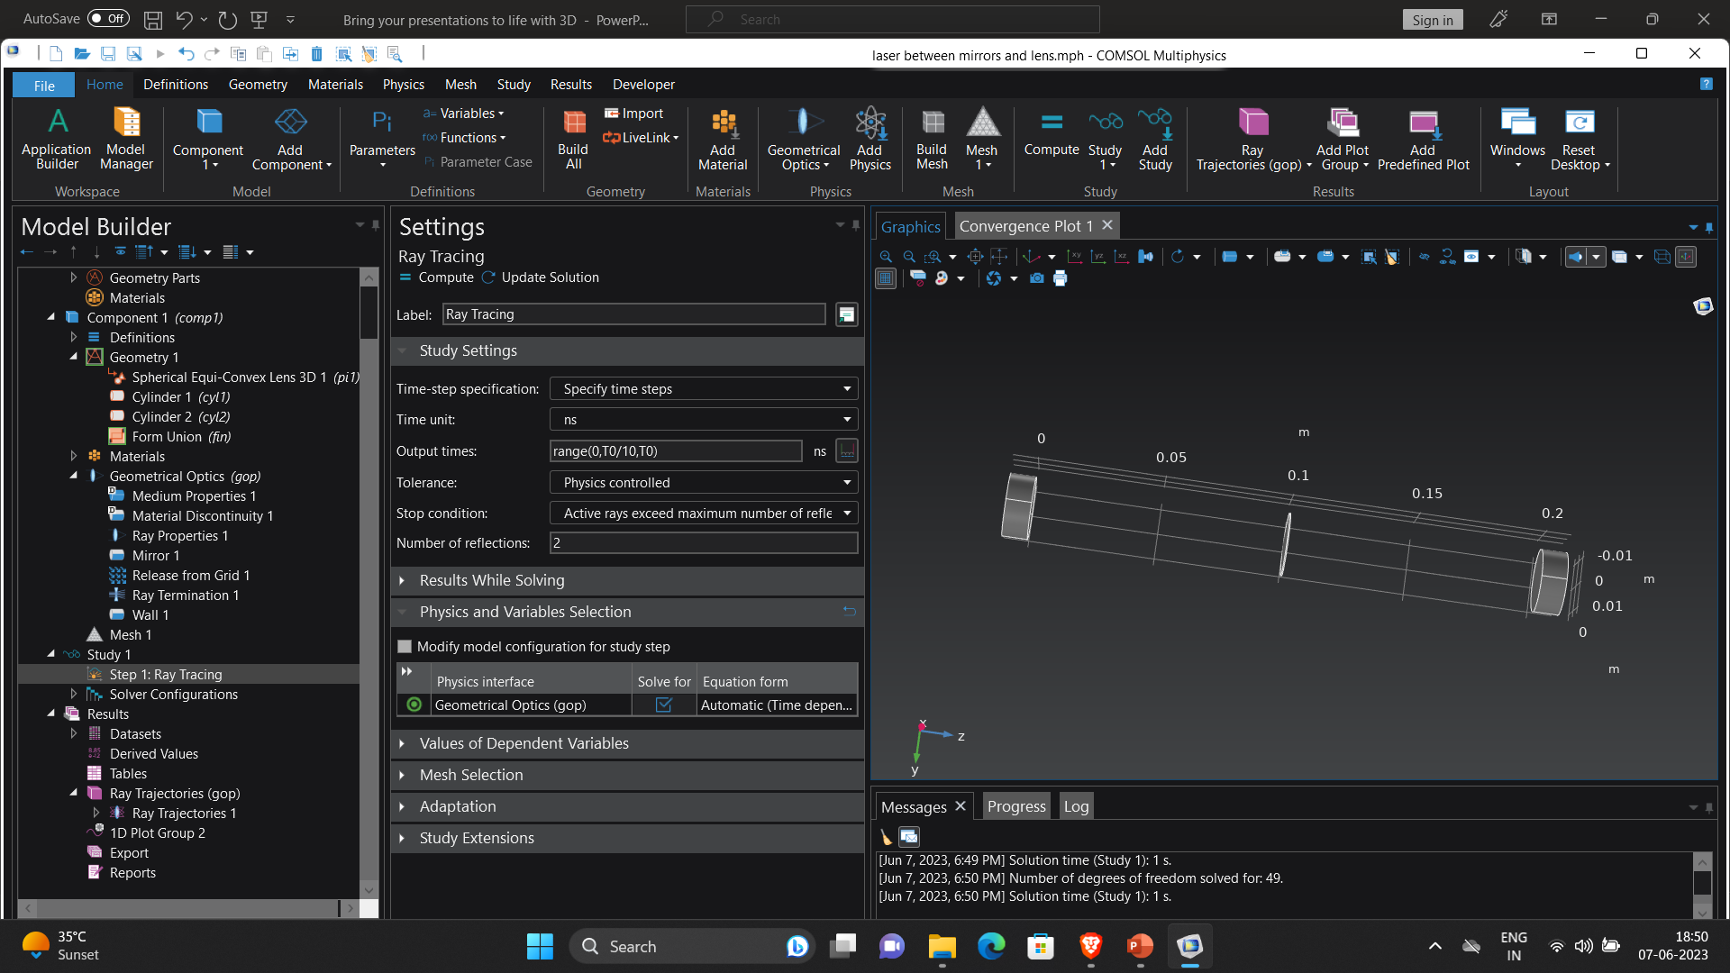
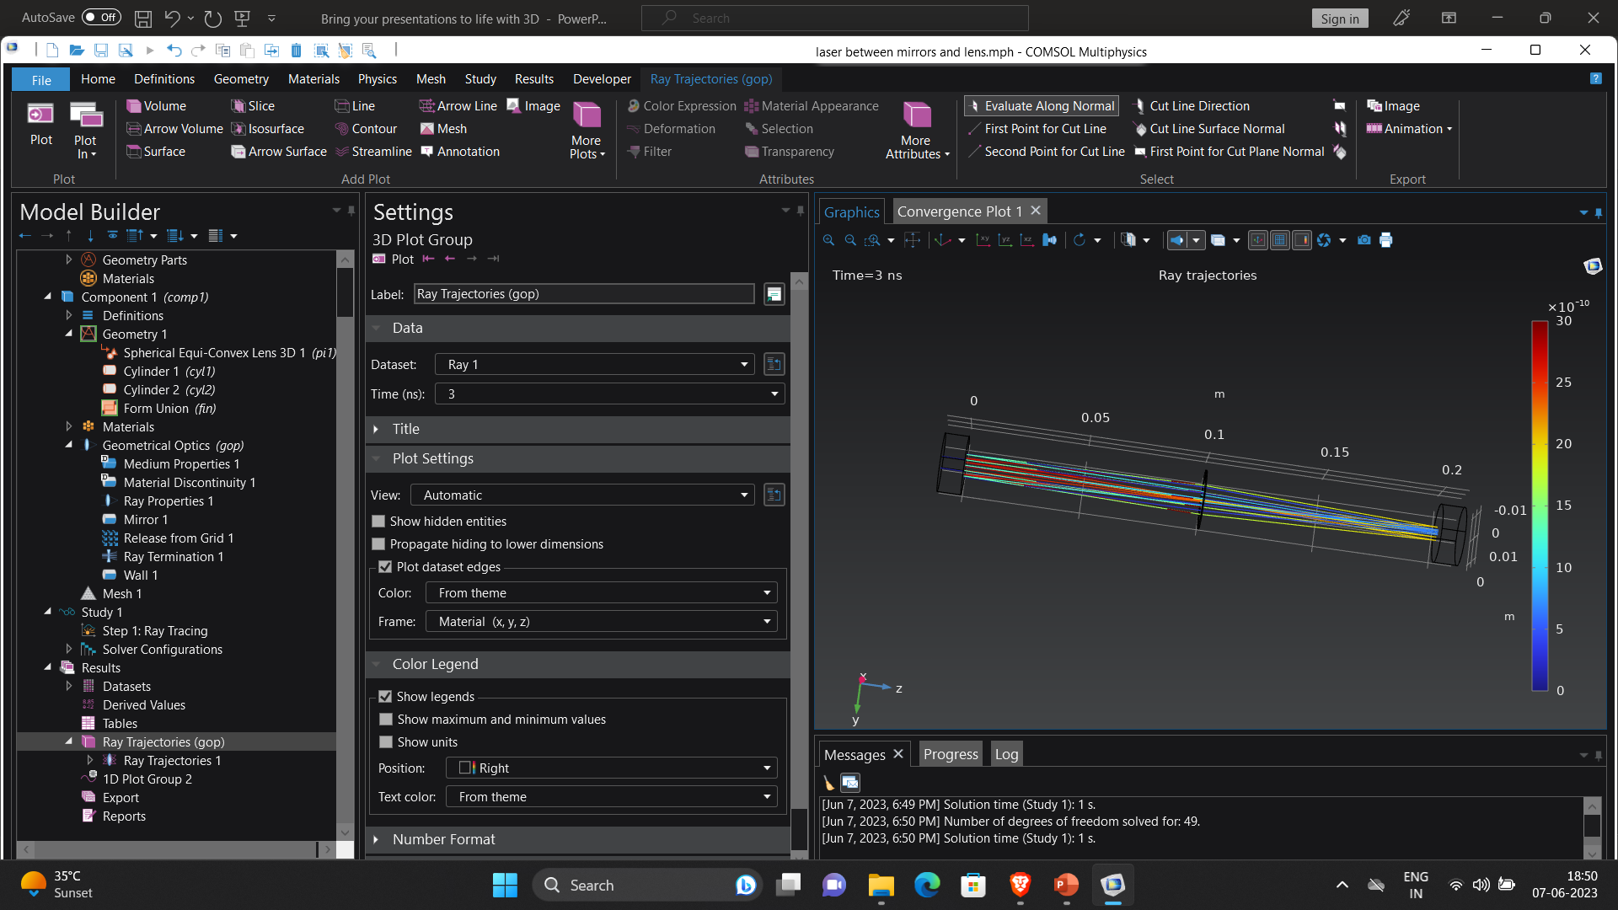

Slide 5
